Slide 1
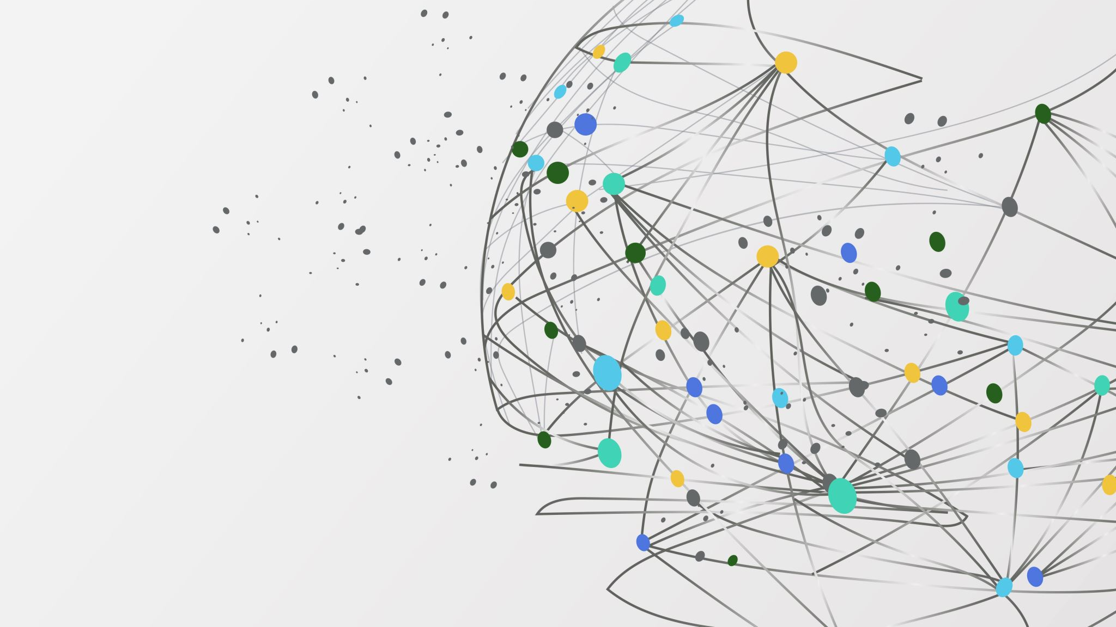
COMP 264 Cloud Machine Learning Professor- Mayy Habayeb Group – 3

Slide 2

Team Members: Group 3
Devanshi Shah (301175169)
Hitesh Dharmadhikari (301150694)
Jefil Tasna John Mohan (301149710)
Nestor Romero (301133331)
Shrikant Kale (301150258)

Slide 3
Introduction
Developing a web application can be used by users to scan business cards and store relevant details in a leads store database.
Majorly automate the tedious and manual task of data extraction.
The web application uses AWS services including textract, s3, comprehend and medical comprehend, and DynamoDB as the database. Users are given the opportunity to manually update any wrong information scanned or to edit any sensitive information.
We are also enabling an authentication service to provide a private and safer experience to users.

Slide 4
Market AI-Enabled Business Cards Organizers
ABBYY BUSINESS CARD READER
RADACAD
YANA AI READER
OFFICE LENS

Slide 5
ML/DL algorithms
Hidden Markov Model
Conditional Random Fields
Support Vector Machine
LSTM (Bi-directional)

Slide 6
Technology Stack Summary
Programming language backend: Python
Programming language frontend: React + Typescript
Data storage: AWS S3, DynamoDB
Software development toolkit: Aws Boto3
Serverless framework: AWS chalice
Testing: Postman to test the individual APIs on localhost and Newman to test the collection on the server.
Operating system: Linux

Slide 7
AWS Services
AWS Textract
AWS Medical Comprehend
AWS Comprehend
AWS S3
AWS DynamoDB
AWS Cognito

Slide 8
Functional Requirements:
Develop a multi-tiered web application that allows a user to upload an image of a business card by means of a web form and receive the results of text detection for:
Names
The application performs entity detection automatically upon receiving the process request from the user and then allows the user to store the data in the application database
Telephone numbers
Email Addresses
Company Name
Company Website
Company Address

Slide 9
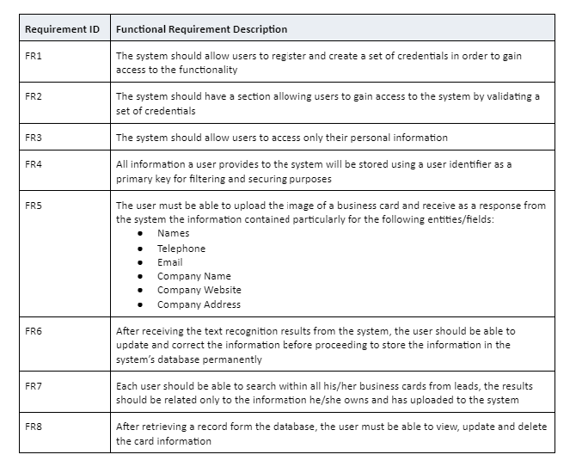
Functional Requirements:

Slide 10
Solution Architecture
Orchestration Layer
Service Layer
Receive a request
Decode the request data object (if required)
call the appropriate service
encode the service response
send the encoded response to the front-end
Store/Retrieve Images (S3 Interaction)
Store/Retrieve Lead Data (DynamoDB Interaction)
Detect Text in an Image (Textract Interaction)
Detect Entities in Text (Comprehend Interaction)

Slide 11
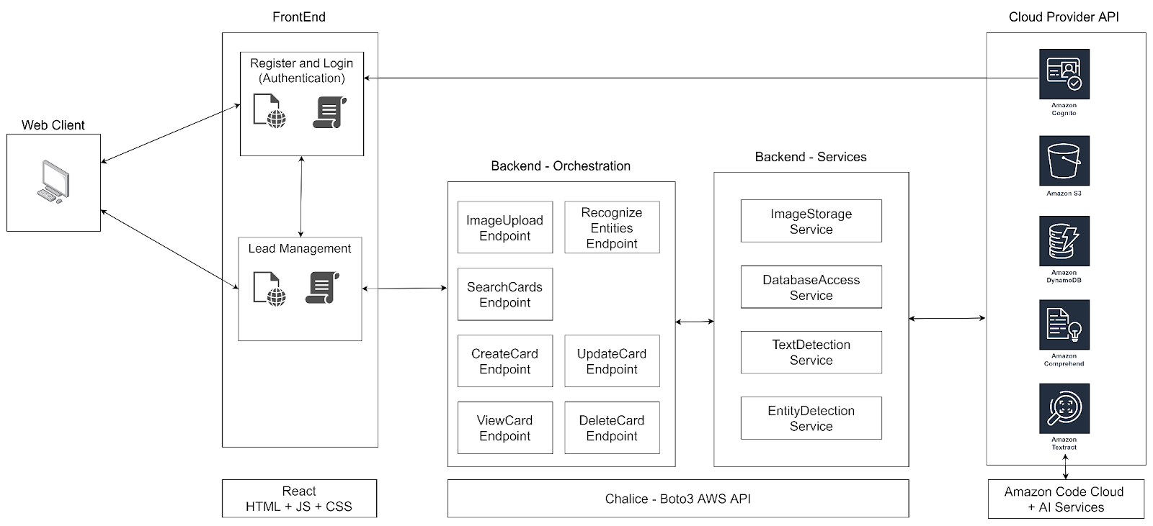
Architecture Diagram:

Slide 12
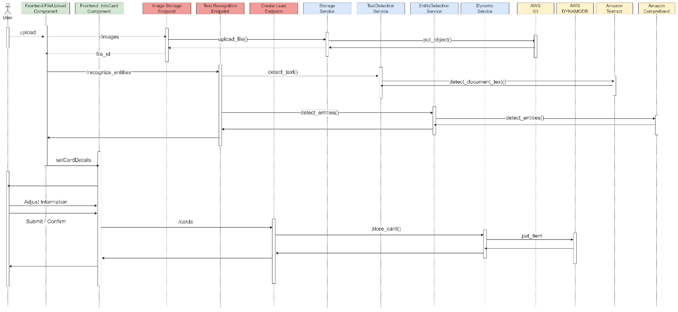
Interaction Diagram:

Slide 13
Solution Endpoints (Private):
Image Storage
Image storage endpoint
Text Detection
Text recognition endpoint
Create Lead / Card
Create lead endpoint
Update Lead / Card
Update lead endpoint
Delete Lead / Card
Delete lead endpoint
View Lead / Card
View lead endpoint
Search Leads / Cards
Lead search endpoint

Slide 14
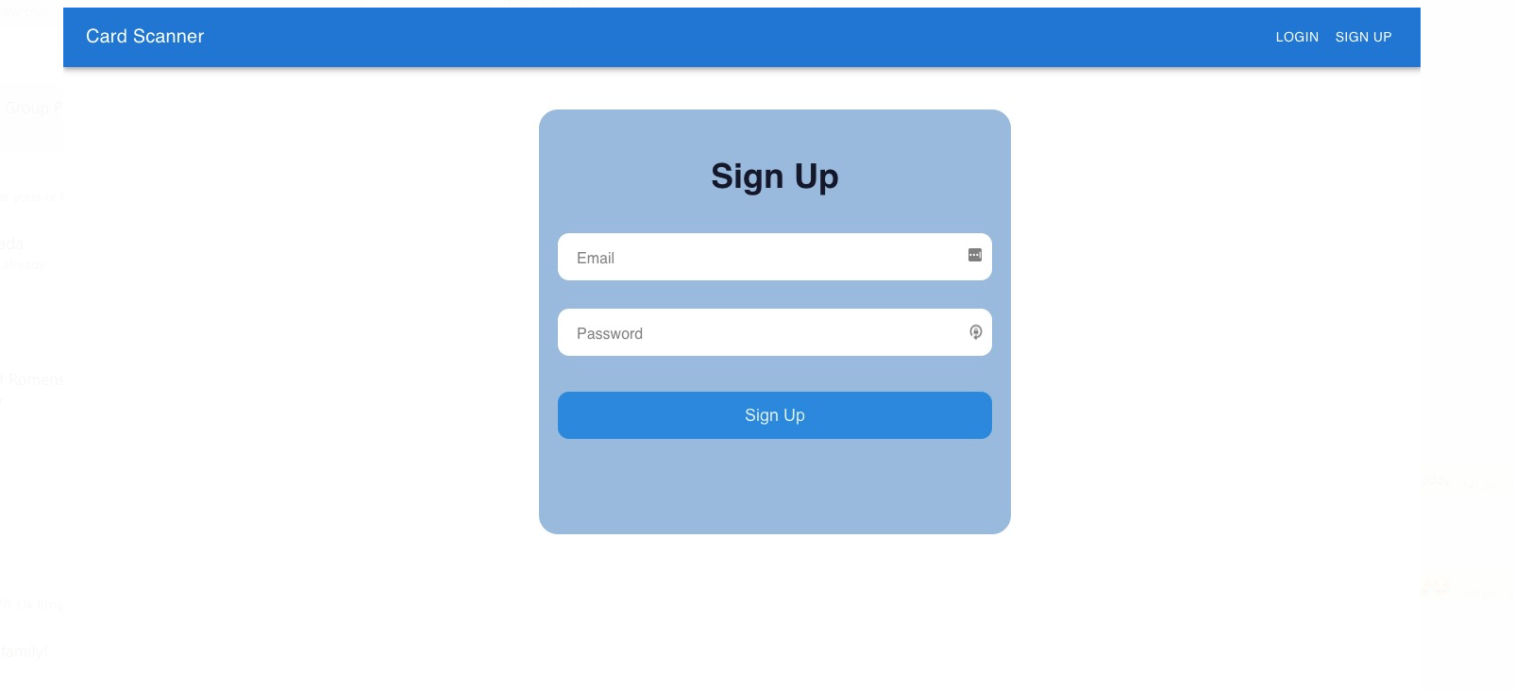
Sign up or register page

Slide 15
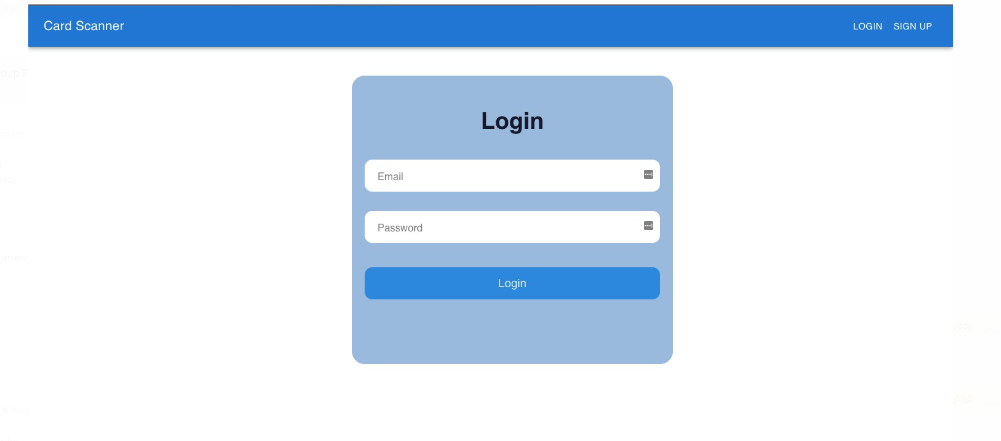
Login page:

Slide 16
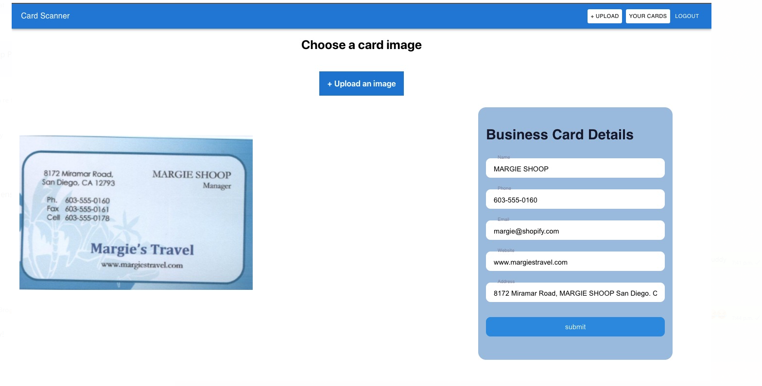
User Interface Mockup:

Slide 17
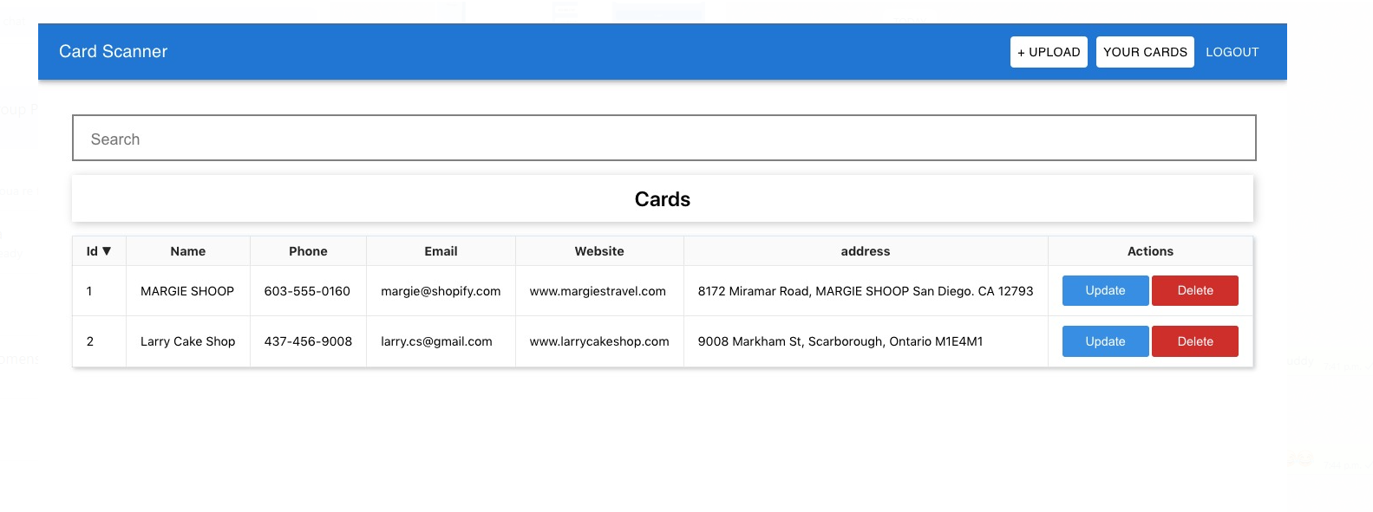
Saved cards

Slide 18
Future Enhancements:
Deploying the application using a Cloud Service Provider
Making the web app mobile responsive
Multiple language support should be added to scan business cards
There should be an email and SMS service added to the application. So, that the user can directly extract information via SMS or email
User should be able to directly make a call, email and visit website from the stored card. This makes communication faster with the organization

Slide 19
ConclusionS
The Business card reader web application developed With the help of AWS services- Textract, S3, comprehend, medical comprehend, DynamoDB, etc is one of the future AI-driven technology that will be very useful in a large event or a company.
This helps reduce a lot of manual work.
Keeps an updated record of business contacts.
Design decision to include humans in the loop ensures that only correct and complete information is stored in the leads store database. This ensures reliability and avoids collecting erroneous data.
An upward trend in the use of cloud services in commercial applications is seen today because of their reliability and out of the box solutions. This application is one such kind.
Can reduce a lot of manual errors.

Slide 20

Demo

Slide 21
References:
Chiu, J. P., & Nichols, E. (2016). Named Entity Recognition with Bidirectional LSTM-CNNs. Transactions of the Association for Computational Linguistics, 4, 357–370. https://doi.org/10.1162/tacl_a_00104
Ekbal, A., & Bandyopadhyay, S. (2011). Named entity recognition in Bengali and Hindi using support vector machine. Lingvisticæ Investigationes. International Journal of Linguistics and Language Resources, 34(1), 35–67. https://doi.org/10.1075/li.34.1.02ekb
Hidden Markov Model - an overview | ScienceDirect Topics. (2021). Science Direct. https://www.sciencedirect.com/topics/medicine-and-dentistry/hidden-markov-model
Morwal, S. (2012). Named Entity Recognition using Hidden Markov Model (HMM). International Journal on Natural Language Computing, 1(4), 15–23. https://doi.org/10.5121/ijnlc.2012.1402
Liao, W., & Veeramachaneni. S. (2009). A Simple semi-supervised algorithm for named entity recognition. Proceedings of the NAACL HLT 2009 Workshop on Semi-Supervised Learning for Natural Language Processing.

